Slide 1

Zomato Analysis Project
Group No: 5

Slide 2
Table of Contents
01
02
03
04
05
Introduction
Data Overview
Key Components
Analysis
Conclusion

Slide 3

Introduction
Our Project utilizes the Zomato Restaurants Data, which comes from one of the most well-known platforms for discovering the best restaurants.
The dataset provides detailed information on numerous restaurants registered with Zomato from across the world.
Key attributes in this dataset include
Votes
Aggregate ratings
Average cost for two

Slide 4

Data Overview
Comprehensive data on a variety of restaurants listed on Zomato in numerous cities across the globe can be found in the Zomato Restaurants Dataset. The dataset offers important characteristics that may be used to examine the restaurant's general performance, clientele, and level of popularity.
Important Dataset Features:
Restaurant Name: The restaurant's name.
City/Location: The restaurant's geographic location.
Cuisine: The kinds of food that are offered at the restaurant.
Availability of Online Orders: Does the restaurant allow customers to place orders online.
Table Booking Availability: Shows whether or not patrons are able to make reservations online.

Slide 5
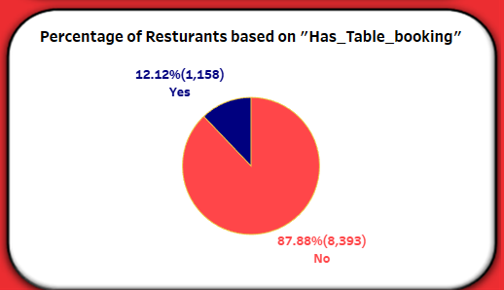
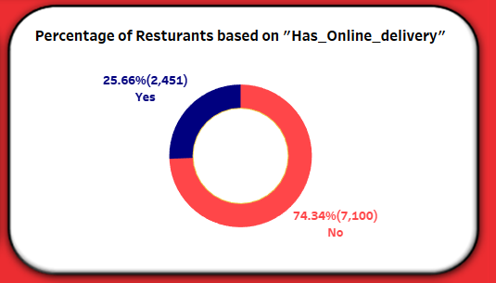
Percentage of Restaurants based on "Has Table booking" & "Has Online delivery"
Key Insights:
Has Table Booking:
Total % Restaurants has No Table Booking: 87.88%
Total % Restaurants has Table Booking : 12.12%
Has Online Delivery :
Total % Restaurants has No Online Delivery: 74.34%
Total % Restaurants has Online Delivery: 25.66%

Slide 6
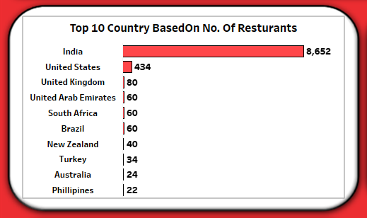
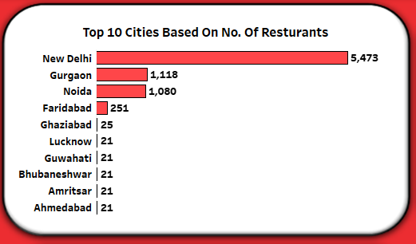
Number of Restaurants based on Country and City Analysis
Zomato's largest presence is in India, where it has captured the majority of the restaurant market. This is followed by the United States and United Kingdom, where the platform has established itself as a reliable source for restaurant discovery and dining experiences.
Emerging markets like the UAE and Australia show potential for growth, as evidenced by the number of listings, which are steadily increasing.
Key Insights:
India represents the largest market for Zomato, with a significant number of restaurants listed in major cities like New Delhi, Gurgaon , and Noida.
Total Restaurants: 8652
India:
United States:
The U.S. is another major market with a large number of high-end and diverse restaurants listed, particularly in cities like New York, Los Angeles, and Chicago.
Total Restaurants: 436
United Kingdom:
The U.K. market shows a robust presence with many restaurants in London and other key cities.
Total Restaurants: 80

Slide 7
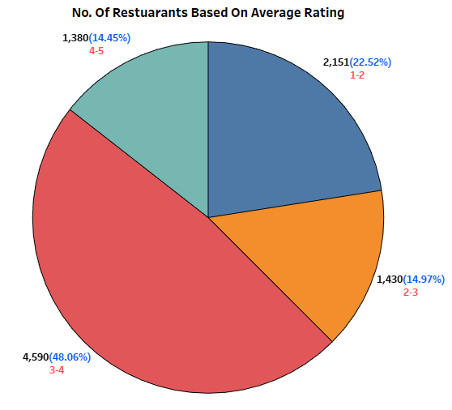
No Of Restaurants Based on Average Ratings
Key Insights:
Highly Rated Restaurants (4 - 5)
These restaurants are typically top-tier establishments with exceptional service, food quality, and customer satisfaction.
Total Count: 1,380 Restaurants.
These restaurants tend to be highly sought after, often fine-dining or niche establishments, and are mostly located in major metropolitan areas.
Well-Rated Restaurants (3 - 4)
The majority of restaurants fall within this rating range, indicating good overall performance and customer satisfaction.
Total Count: 4590 Restaurants
Moderately Rated Restaurants (2– 3)
Restaurants in this range are satisfactory, offering decent dining experiences, though with potential areas to enhance food quality, service, or ambiance.
Total Count: 1430 Restaurants
The Majority of Restaurants fall into the Well-Rated Restaurants categories (3-4) reflecting generally positive customer experiences on Zomato.

Slide 8
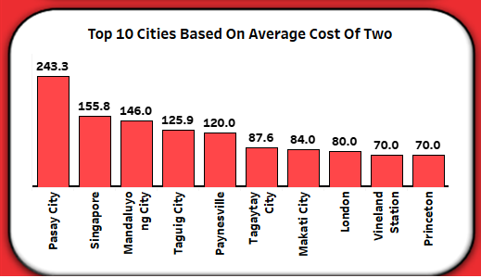
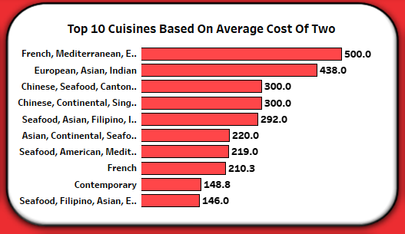
Average Cost Of Two based on Cuisine and City
Key Insights:
Luxury Restaurants (300 – 500)
The higher price reflects the fine dining experience and use of premium ingredients
Luxury restaurants provide a high-end dining experience, featuring gourmet menus and exclusive services.
These restaurants cater to affluent customers and are usually found in major urban centers or premium hotel chains.
Mid-Range Restaurants (200 – 300 )
These cuisines offer diverse flavour profiles and generally priced at a mid- range level.
Mid-range restaurants strike a balance between affordability and quality,
Attracting a wide customer base for both casual and semi-formal dining experiences.
Low-Cost Restaurants (100 - 200)
These cuisines are often more affordable and popular in casual dinning setting.
This category represents budget-friendly restaurants, which are often casual dining or quick-service outlets.
These restaurants cater to a price-sensitive customer base.

Slide 9
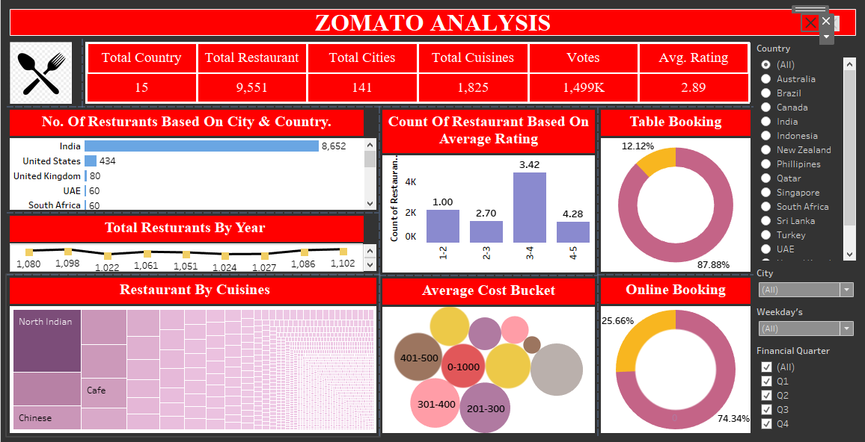

Slide 10
Key Learnings
Restaurant Trends
Cuisines Popularity: Certain cuisines dominate specific regions, revealing consumer preferences and helping restaurants tailor their offerings to the market's demand.
Pricing Insights: Restaurants with higher costs generally attract more affluent customers, whereas more affordable options cater to a larger audience.
Location Impact: The location of restaurants greatly influences customer footfall. Restaurants located in prime or accessible areas tend to have higher ratings and more customers.
2. Consumer Preferences
Rating Analysis: Analyzing ratings reveals trends about customer satisfaction. Restaurants with higher ratings tend to have better reviews and are more likely to maintain loyal customers.
Price-to-Value Ratio: There is a correlation between the cost for two and ratings, where value-conscious customers seek affordable, high-quality food.
3. Market Segmentation
Type of Restaurants: Categorizing restaurants into fine-dining, casual, cafes, and quick-service provides insights into how the target audience differs for each type.
User Sentiments and Reviews: Text mining and sentiment analysis of reviews provide detailed insights into customer preferences, pain points, and expectations, which helps in improving customer experience.

Slide 11

05
Conclusion
By analyzing Zomato's dataset, we can gain actionable insights that help restaurant owners understand customer preferences, optimize their offerings, enhance their marketing strategies, and improve their overall service and customer satisfaction. This data-driven approach can give restaurants a competitive edge in a dynamic market.

Slide 12


Thank You!

